Slide 1
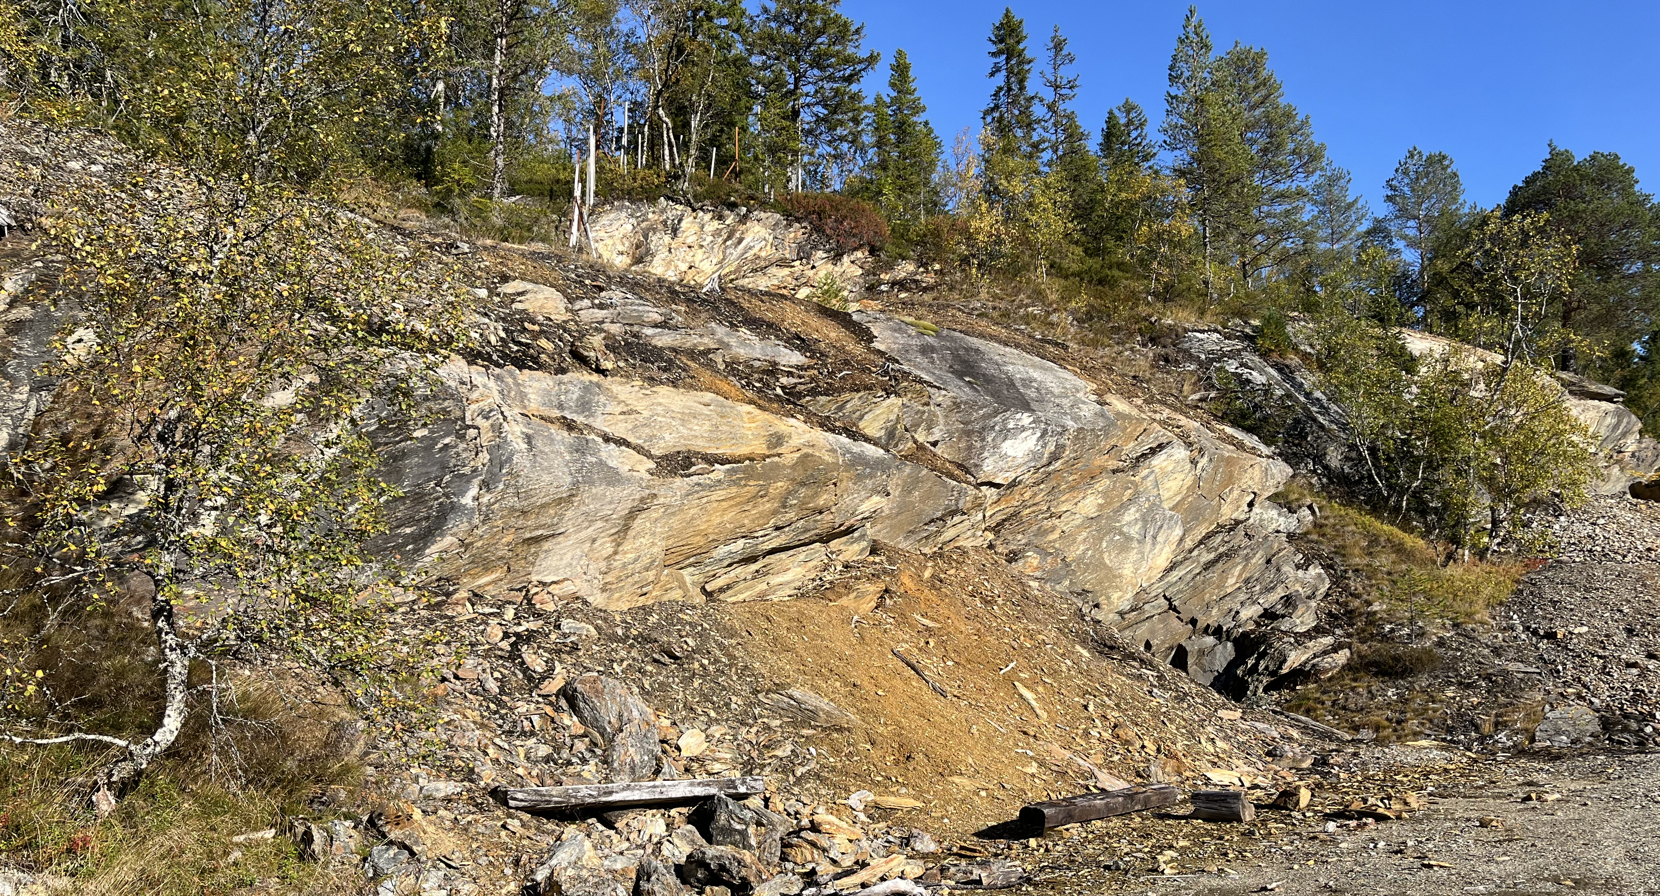

OCTOBER 2025
INVESTOR RELATIONS PRESENTATION
PURE MINERALS AS
PROSPECTING AND
SEARCH FOR MINERAL DEPOSITS
COMPANY REGISTRATION NUMBER NO 928 309 231

Slide 2
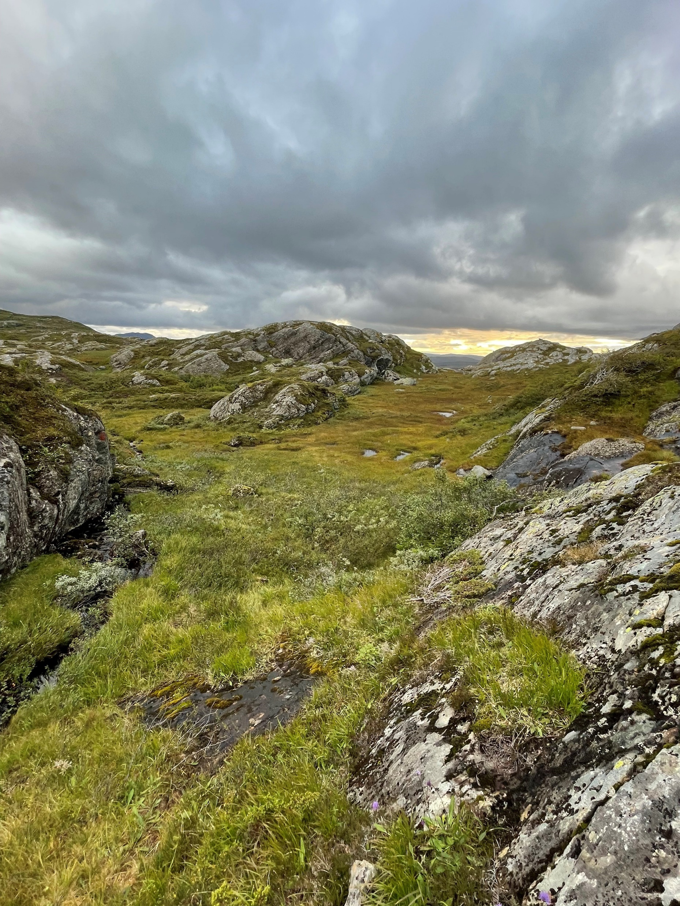
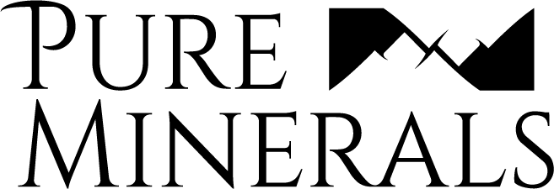
WHO ARE WE, AND WHAT IS OUR STORY?
The exploration company Pure Minerals AS is in the process of
developing several of their mining licenses in the Steinkjer area,
Trøndelag County, Mid-Norway.
During late 2021 and throughout 2022, we explored several of the Gaulstad and Mokk mines entrances at Gruvfjellet. These internal surveys comprised XRF-measurements prior to sampling of bedrock and rock waste dump material for geochemical analysis.
In late 2022 and 2023 we engaged Sunnfjord Geo Center AS and GeoVista AB
both executed high performance geological mapping combined with evaluation of existing geophysical data in the Gaulstad-Mokk area, respectively.
The latter included also the Skrattås and Bjønsåsen mining area at Byafjellet in their fieldwork, as basic work for their further plan for a following up geophysical TEM-survey in late 2025.

Slide 3
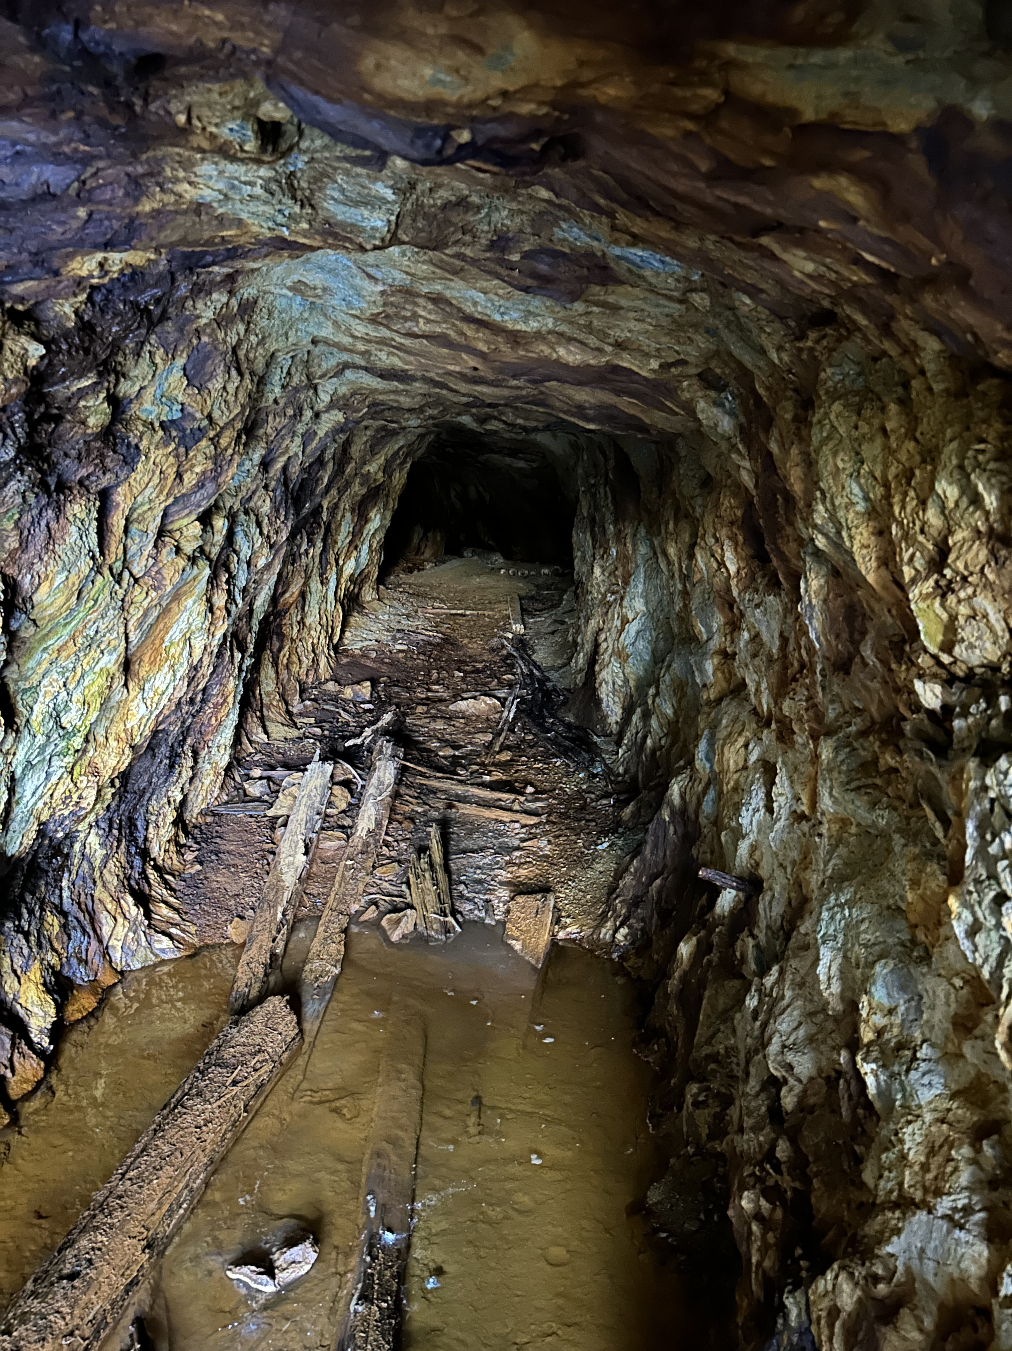
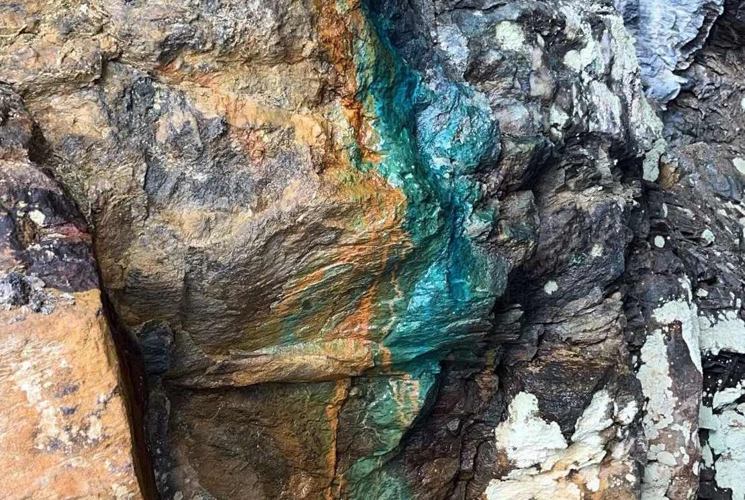
LICENSES AND RIGHTS
Pure Mineral AS holds 11 mining licenses in the Gaulstad and Mokk area, covering an approx. 110 km² sized area, surrounding the Gruvfjellet mountain plateau. In addition, we hold 7 more very promising licenses in the area surrounding the old Skrattås zinc mine, north of an old lead mine ("the silver mine") in Offenåsen.
GAULSTAD - MOKK
The mining history in the upper Ogndalen area started when a major copper ore (Cu) was discovered in 1760, in the Gruvfjellet plateau and by 1764 the Gaulstad No. 1 mine was in full operation. A few years later the Mokk no. 1 mine "Blankstøiten" followed up.
This historical first phase for copper mining was continued in 22 years until 1786. The next 20-year during 1830-1850, the last mining period was from 1880-1891 targeting nickel (Ni).
For the last 130 years many governmental and private entities have explored the more than 50 identified worded mines and minor test pits throughout the area. Pure Minerals acquired their licenses in 2021-2022.
SKRATTÅS - BYAFOSSEN
In the Skrattås license block, test mining was conducted 1886-1914 by several owners and in 1925-1927 the mine registered constant zinc mining production.
DRAFT – 13.03.2023

Slide 4
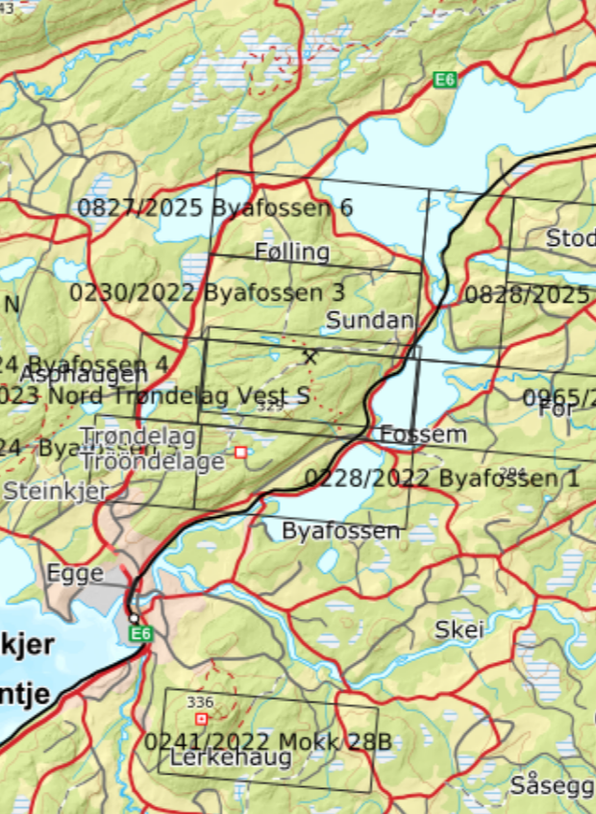
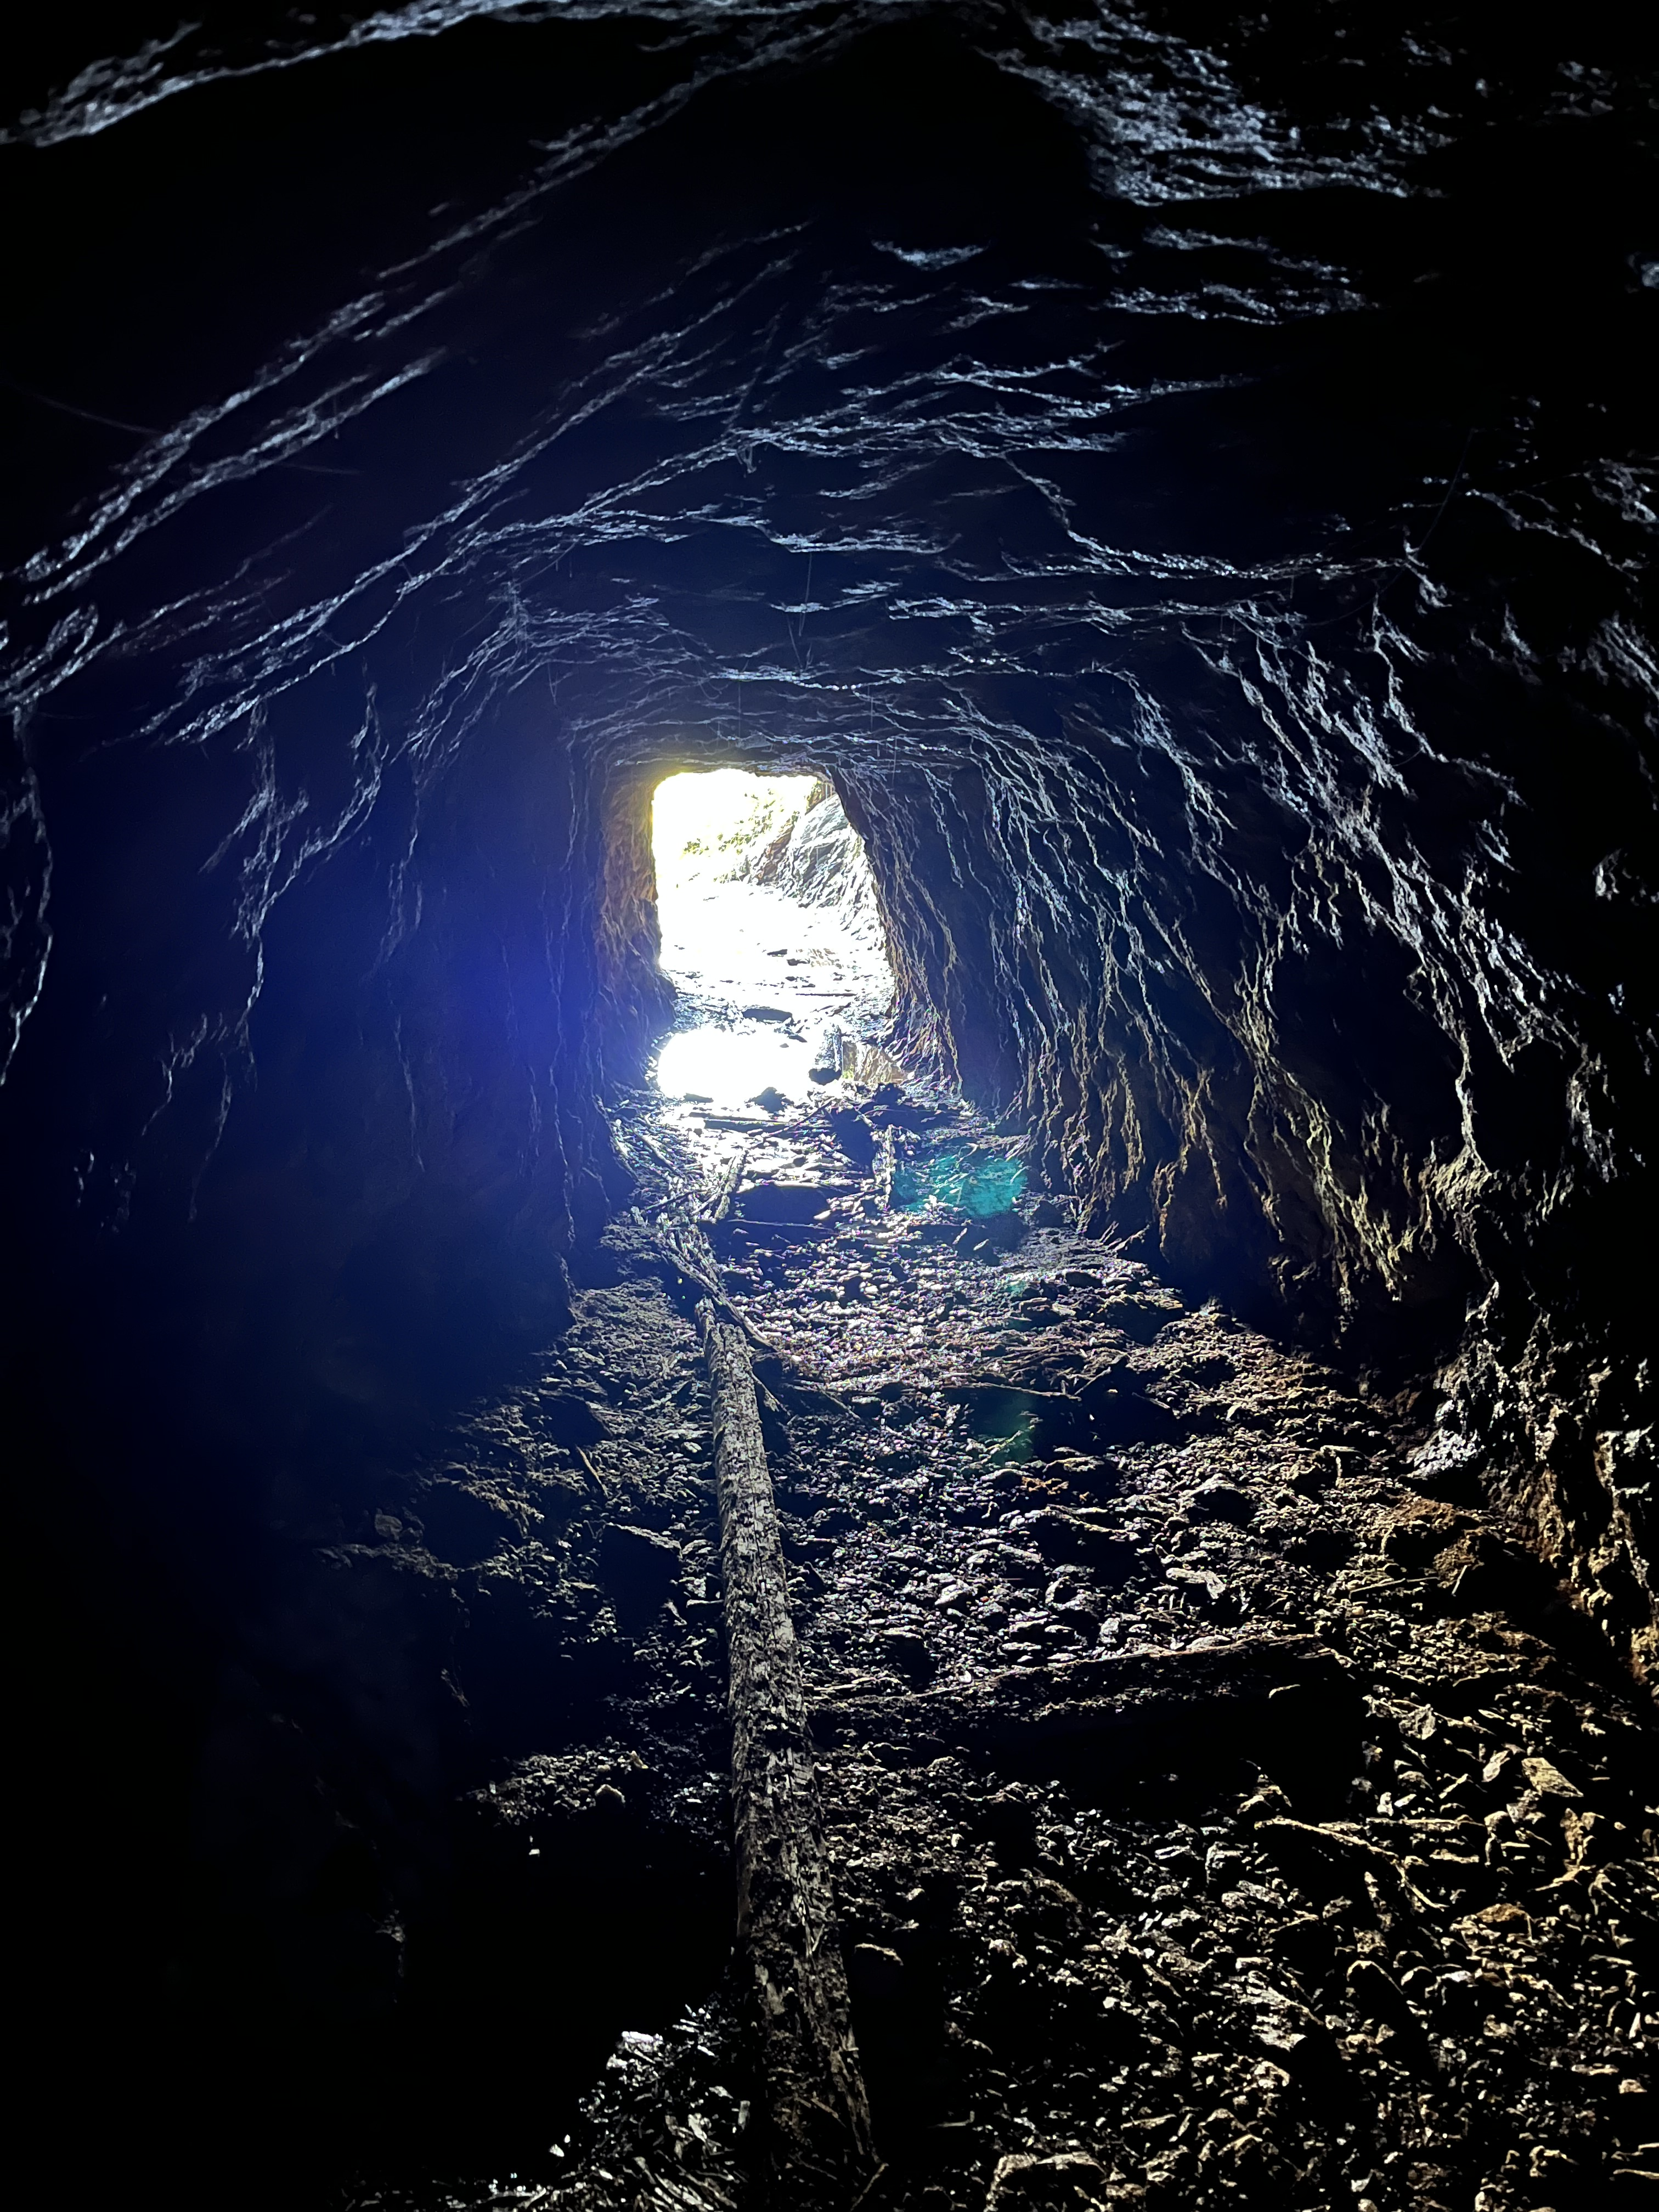

LICENSES AND RIGHTS
SKRATTÅS - BYAFOSSEN
Test mining was conducted during 1886-1914 by several owners and in 1925-1927 the mine registered constant production. The estimated reserve for this deposit was 80.000 tons with up to 1.5% Cu, 7% Zn and 2.5% Pb.
From the above was 5.000 tons mined during 1979-1981 and the average quality grade of the produced ore was reported to be 34% Zn, 10.4 %Pb and 1.9% Cu.
The underground work terminated at 80 m depth, however, the mineralization continue downwards. The mineral body here is tabular, including both massive sulphides and disseminations alternating on a thickness between 0.4 and 2.6m.
Drilling in the adjacent Bjønsåsen mining area have proved significant high grades of copper, while Skrattås in addition shows a potential for both silver and gold.
6
7
3
4
2
5
1
7
50
Licenses
$${km}^{2}$$
28B
DRAFT – 13.03.2023

Slide 5
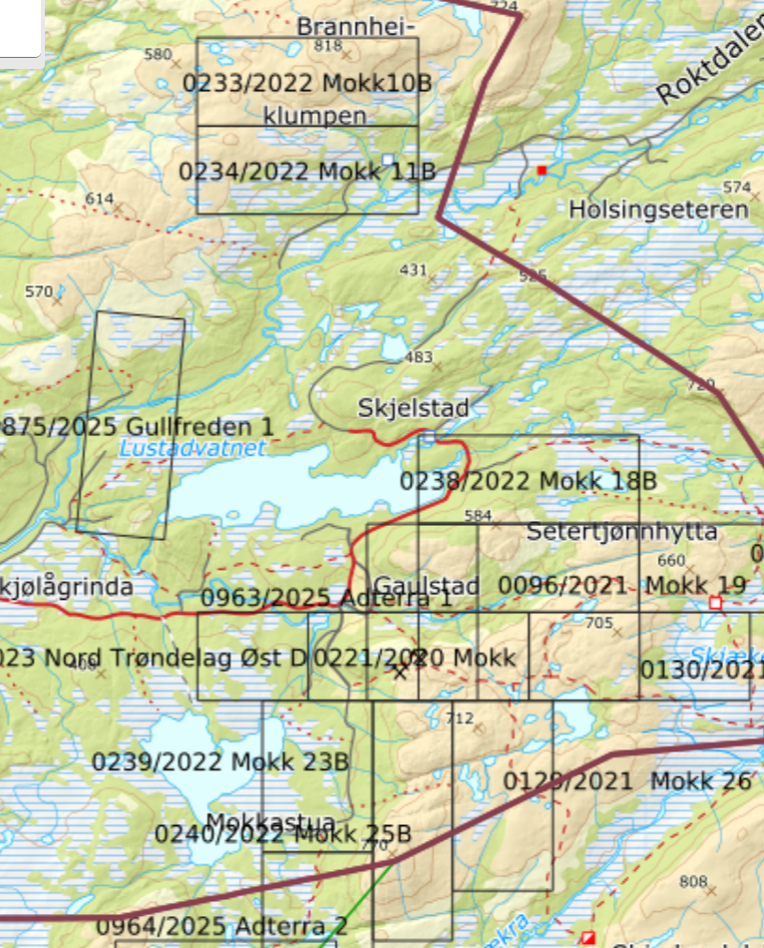
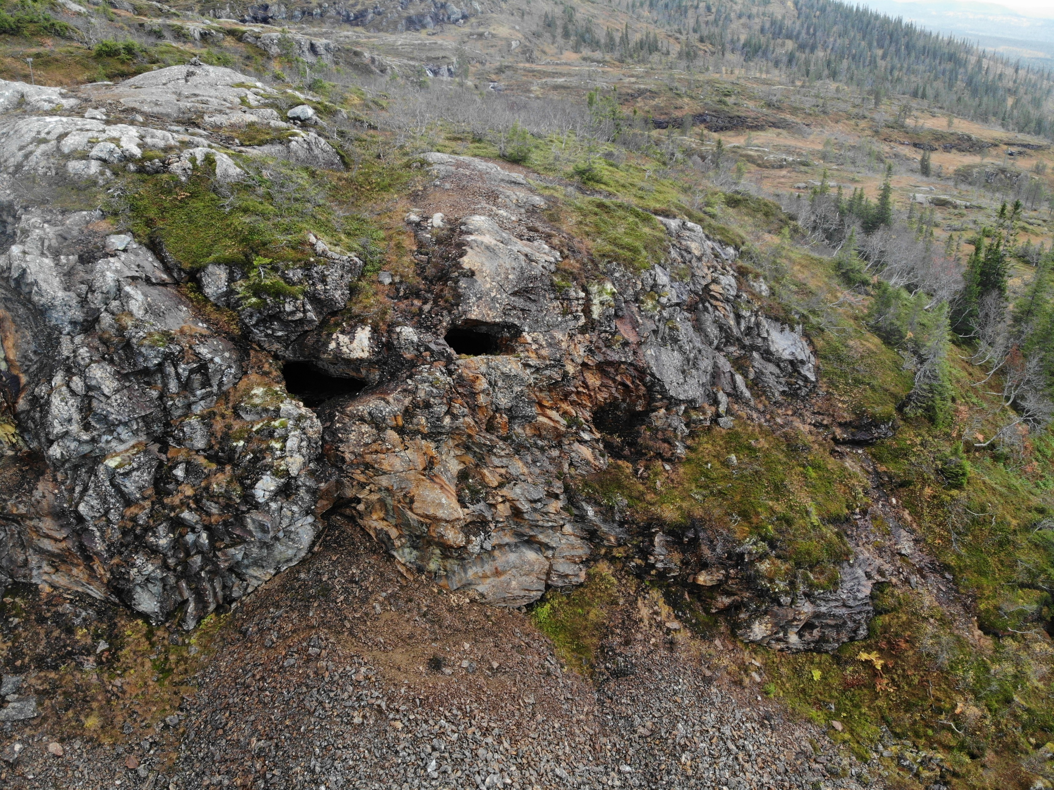

10B
LICENSES AND RIGHTS
GAULSTAD - MOKK
11B
This old mining area from the mid 1700s is still insufficiently explored. More than 50 worded mines and test pits in this Gaulstad - Mokk licence block, have over the years documented a good potential for economic mineralization. Geological field work was carried out in 2023 by GeoVista AB and SGC AS respectively, covering approx. 3 of the W to NW licenses. Further geological and geophysical exploration is planned to be carried out in 2026.
18B
19
9B
0221
22
23B
25B
26B
11
110
Licenses
$${km}^{2}$$

Slide 6
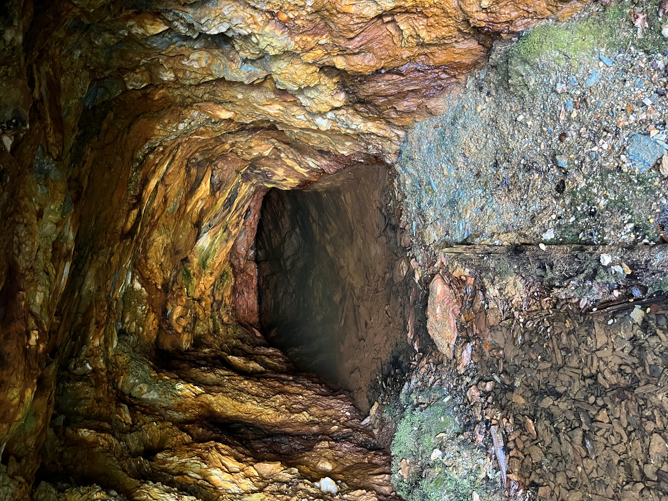
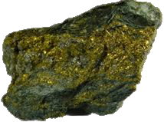
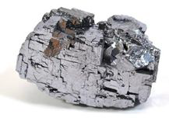
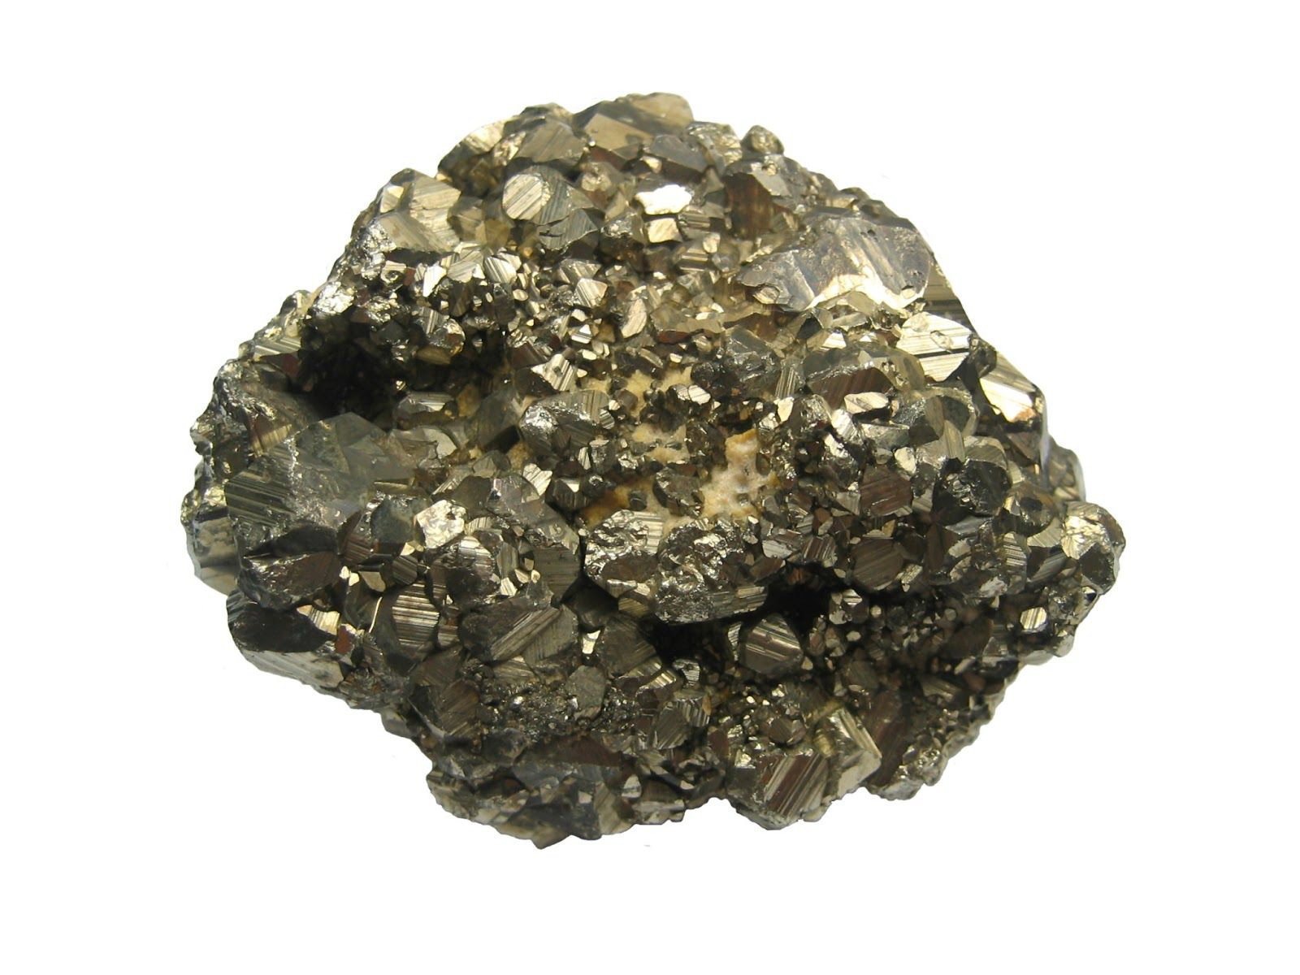
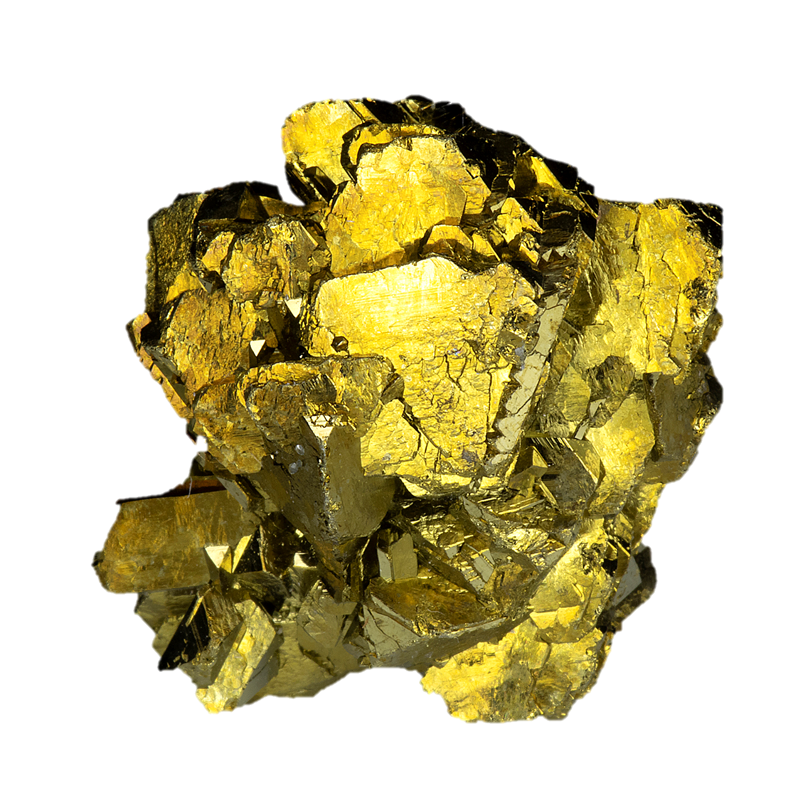
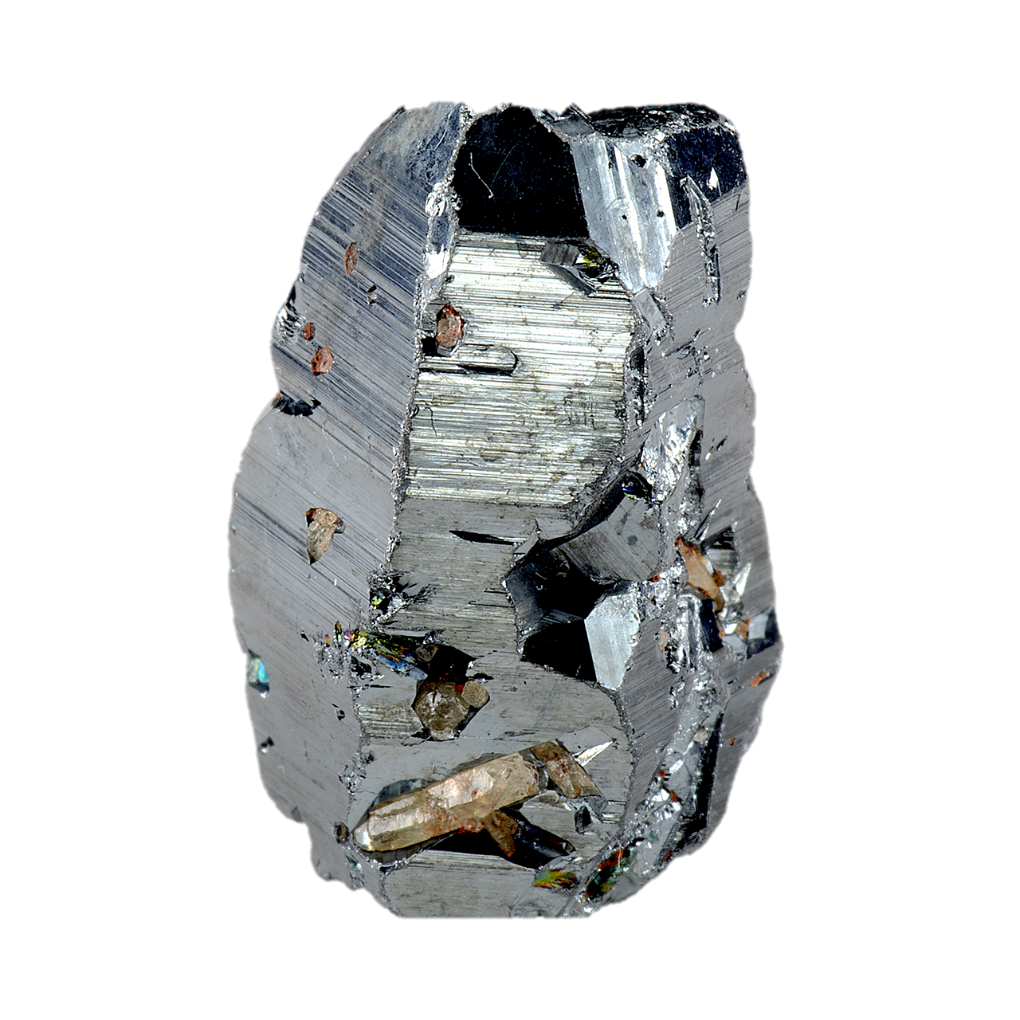
The dominating mineralization all over the exploration area is found as both copper sulphide (CuFeS₂) and iron sulphide (FeS₂). Locally some other sulphides may be found, e.g. zinc sulphide or sphalerite (ZnS) and lead sulphide or galena (PbS). These and a few other metals is included in the suite base metals.
Following the base metals occurrences are notable concentration of precious metals like silver (Ag) and gold (Au), along with trace amounts of platinum (Pt), palladium (Pd) and rhodium (Rh). Additional some strongly needed rare elements in the electronic industry like indium and REE (Rare Earth Elements). More than 70 elements have been analyzed so far and found,
EXAMPLE OF OCCURRENCE
LICENSE AREA
ELEMENT | UNIT | MOKK | SKRATTÅS
Cu (Copper) | % | 7,95 | 7,01
Zn (Zinc) | % | 1,24 | 28,8
Pb (Lead) | % | 0,005 | 9
Ag (Silver) | ppm | 12,45 | 539
Au (Gold) | ppm | 0,05 | 10,01
Ni (Nickel) | ppm | 225 | 49,5
Co (Cobolt) | ppm | 840 | 29
As (Arsenic) | ppm | 209 | 47,9
Mo (Molybdene) | ppm | 71,3 | 411
Ti (Titanium) | ppm | 8130 | 2170
V (Vanadium) | ppm | 286 | 425
Cr (Chromium) | ppm | 429 | 495
Mn (Manganese) | ppm | 3120 | 2150
Fe (Iron) | % | 34,0 | 20,1
MINERALS OCCURENCES

Slide 7
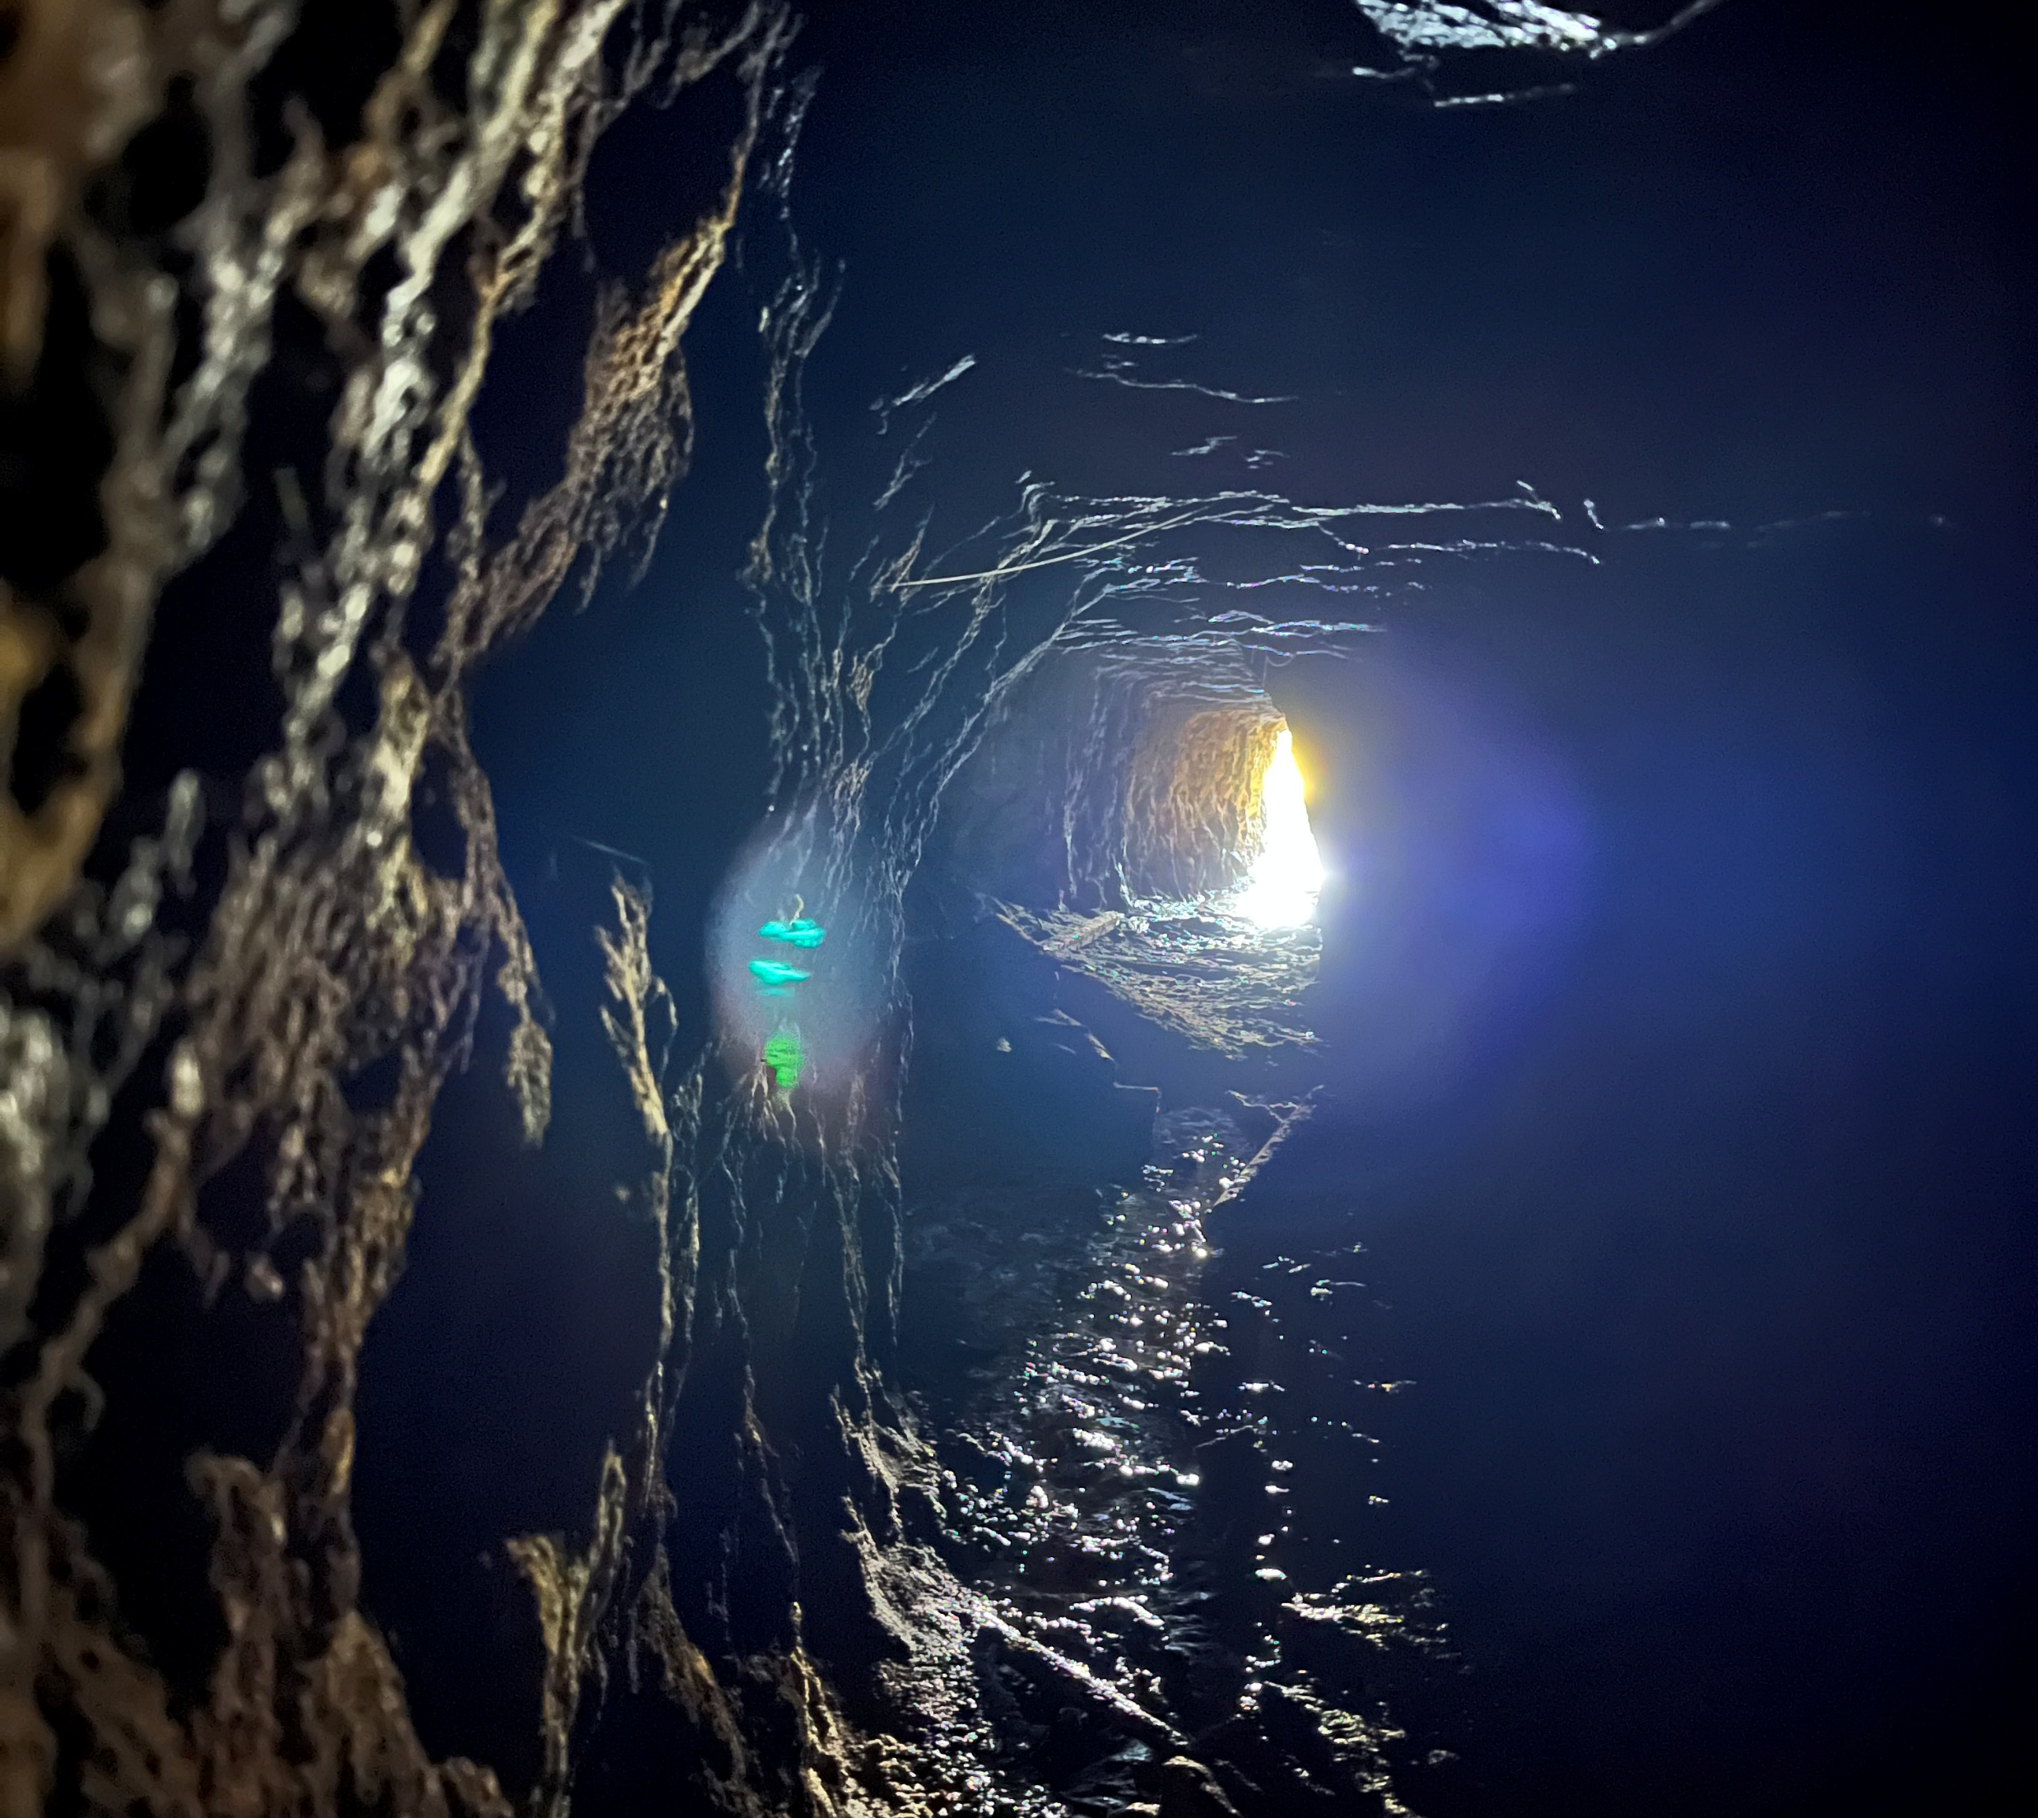
CONTACT US FOR FURTHER INFORMATION
Chairman Jon Olav Slettebakk
+47 97 52 13 57
jon.olav.slettebakk@elementmontering.no
www.pureminerals.no

